Slide 1
Catalogued Threatened Species:
Who and where are they?
Group 2
Seth Carlyon, Gaby Garcia, Graham Jaeger, Kyle Murphy, Timothy Salazar

Slide 2
Questions
How representative are current assessments of threatened species?
Are there biases?
Is there an association between a species' occurrence and its threat category?
How does spatial range affect threatened status?
Has a large percentage of the species' vital habitat been degraded or destroyed?

Slide 3
Data Sources
IUCN Red List API
https://www.fishbase.se/
https://www.iucnredlist.org/resources/spatial-data-download

Slide 4
Exploration of IUCN data
•Global Assessment n = 153,732
•European Assessment n = 16,226
•Pseudo-random sample n = 10,000 from each

Slide 5
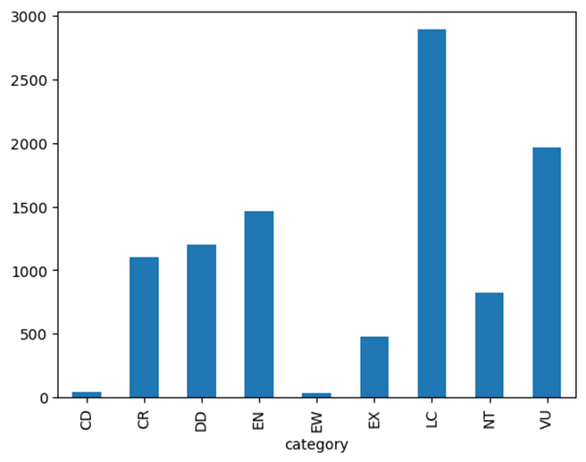
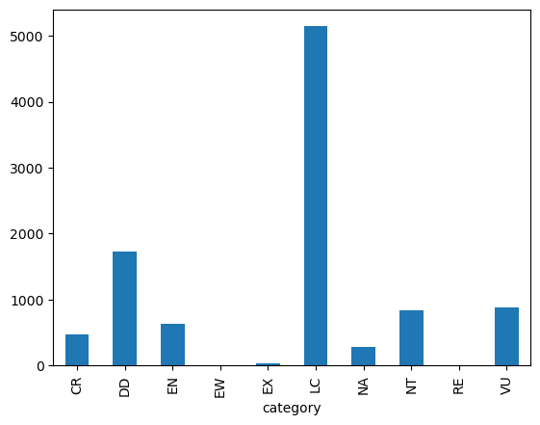
Global Assessment
European Assessment
•Most species are labeled ‘Least Concern’, especially in the European data
LC: Least concern
VU: Vulnerable
DD: Data Deficient

Slide 6
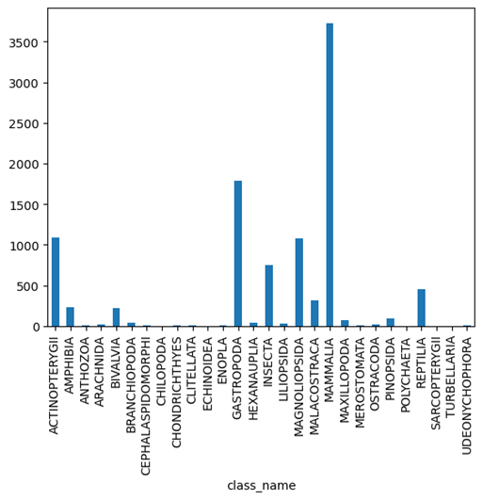
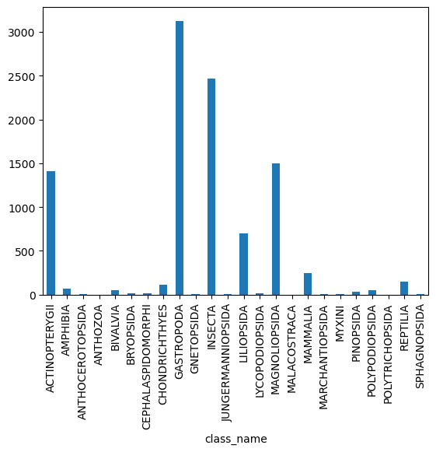
Global Assessment
European Assessment
•Sample skews towards Animalia over Plantae
•Mammalia (Global) and Gastropoda (European) are the most common classes

Slide 7
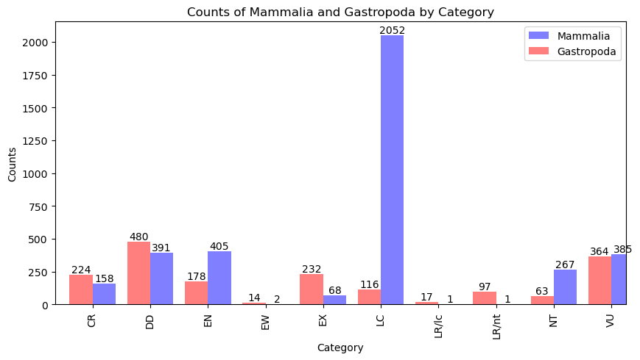
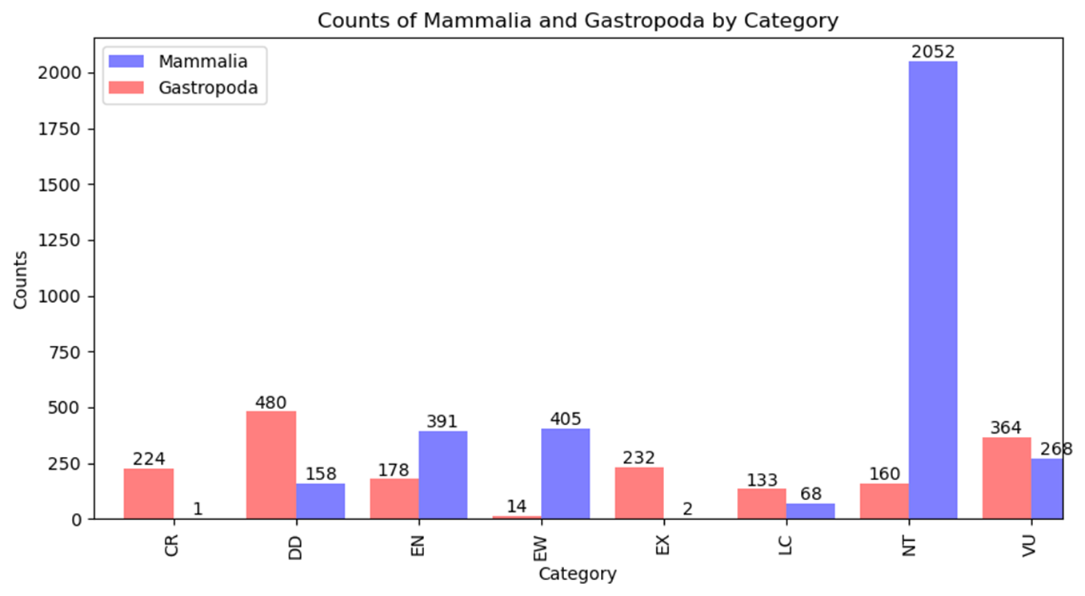

Slide 8
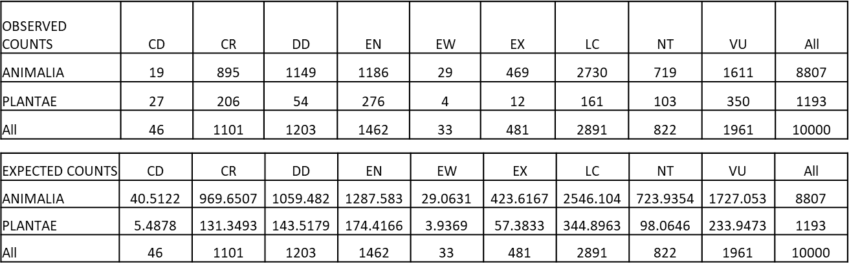
Does an organism’s Kingdom relate to its threatened status?
•H₀: Kingdom is independent of Category
•H_{A}: Kingdom is a predictor of an organism’s category.
•Test this with a chi-square test

Slide 9
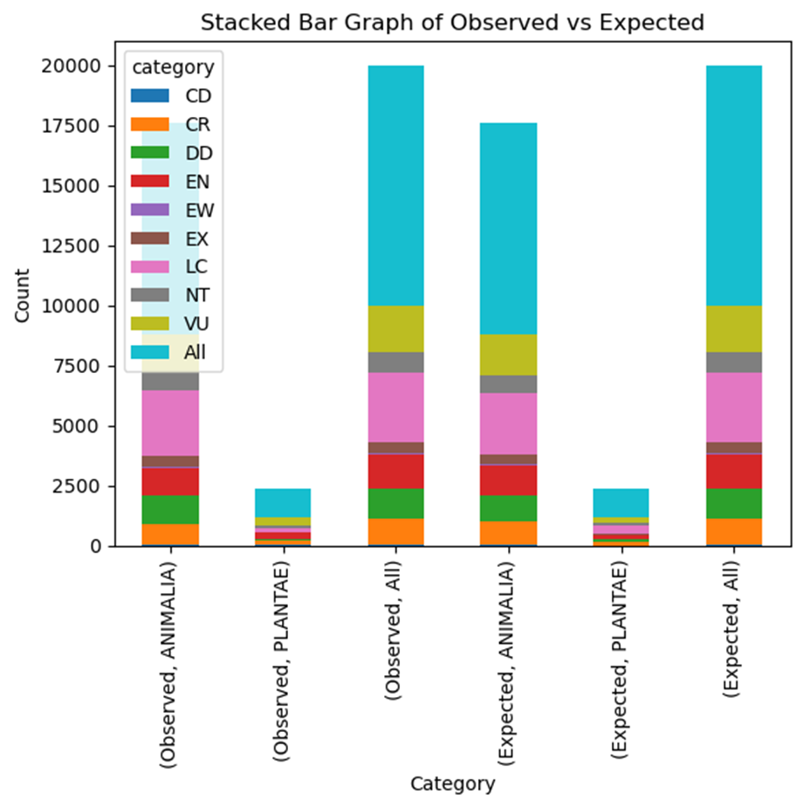
Chi-square results
•Chi-square statistic: 492.24
•Degrees of freedom: 18
•p-value: 4.45e-93
A follow-up analysis of Class’ impact on category was also significant
Chi-square statistic: 5172
Degrees of freedom: 308
p-value: 0.0

Slide 10
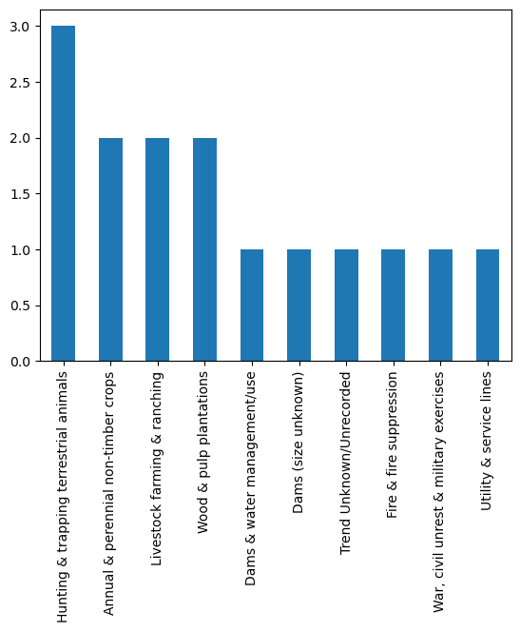
Threats
Sample
Specie:Loxodonta africana
Common name: African bush elephant
Top 3 threats:
Hunting & trapping terrestrial animals
Livestock farming & ranching
Annual & perennial non-timber crops

Slide 11
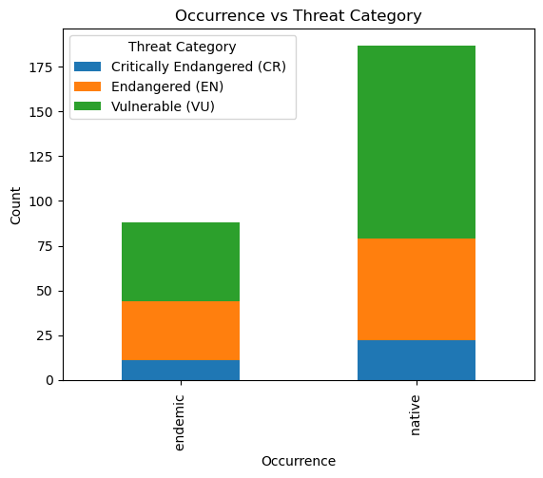
Endangered Fish in
The United States
•https://www.fishbase.se/

Slide 12
Chi-square results
Null hypothesis:
There is no association between a species' occurrence and its threat category. In other words, the occurrence of a species does not affect its threat category.
Alternative hypothesis:
There is an association between a species' occurrence and its threat category. In other words, the occurrence of a species does have an effect on its threat category.
P-value: 0.45414695

Slide 13
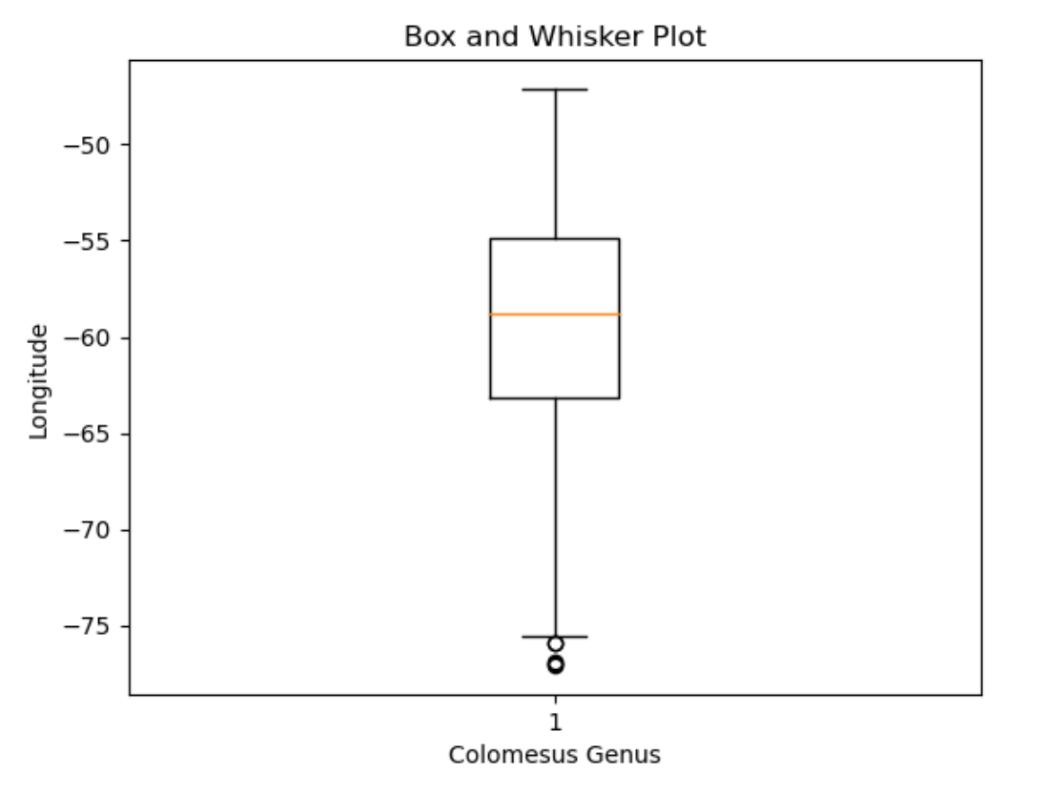
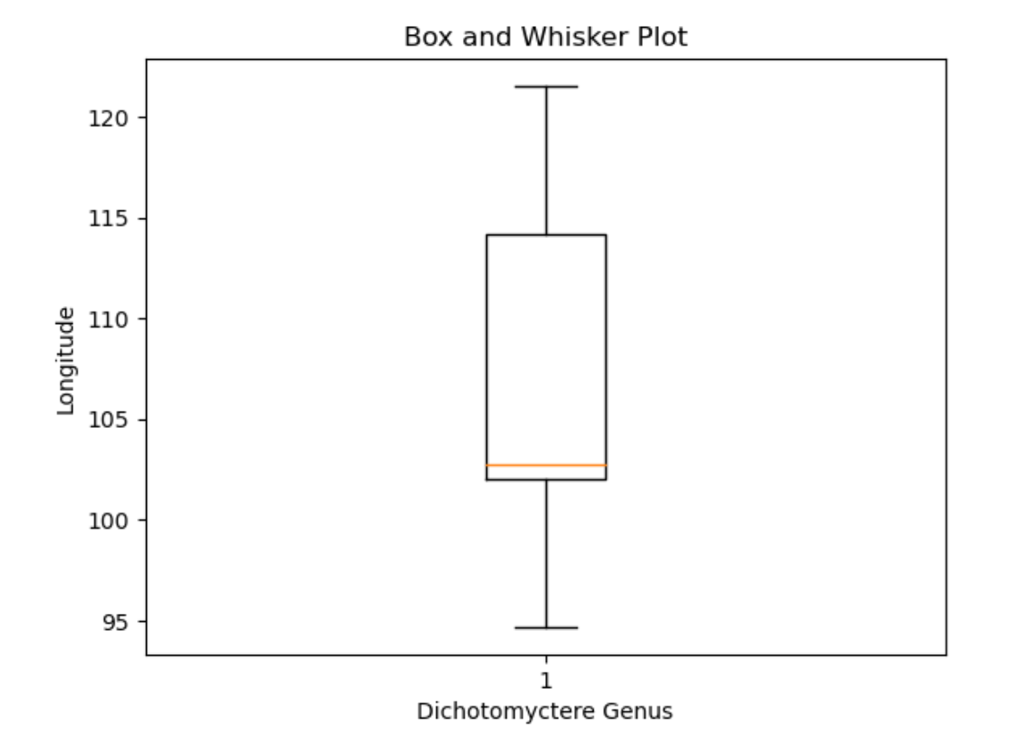
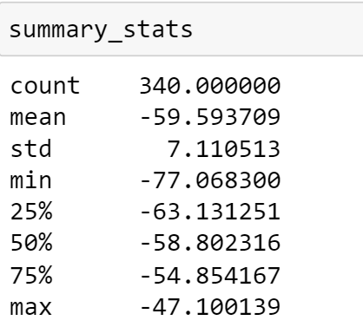
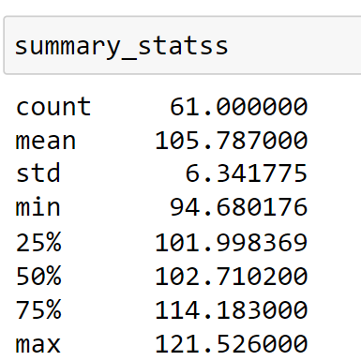
Colomesus & Dichotomyctere Pufferfish:
longitude distributions
Hypothesis:
Null - There is no noticeable difference in the mean longitudinal distribution of the two genera of pufferfish
Alternative - There is a noticeable difference in the mean longitudinal distribution of the two genera of pufferfish
https://www.iucnredlist.org/resources/spatial-data-download

Slide 14
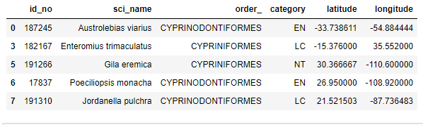
Mapping data
Drawing hypothesis from mapping data
Building what we wanted to with the API (using a limited csv)

Slide 15
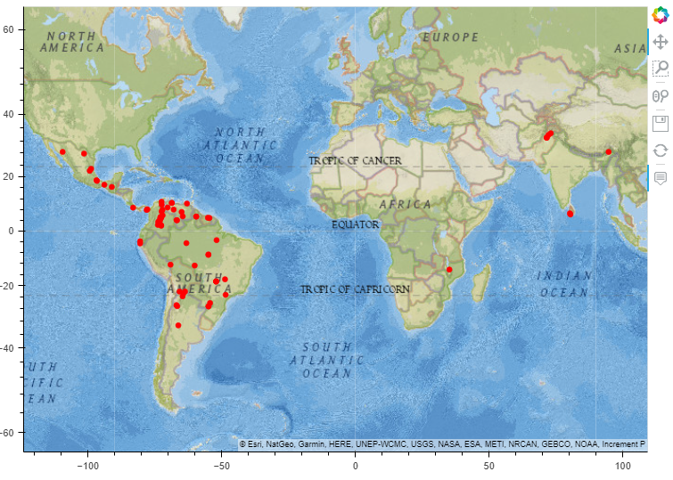
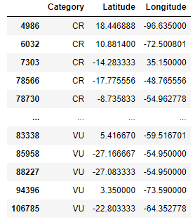
Map examples for most severe categories

Slide 16
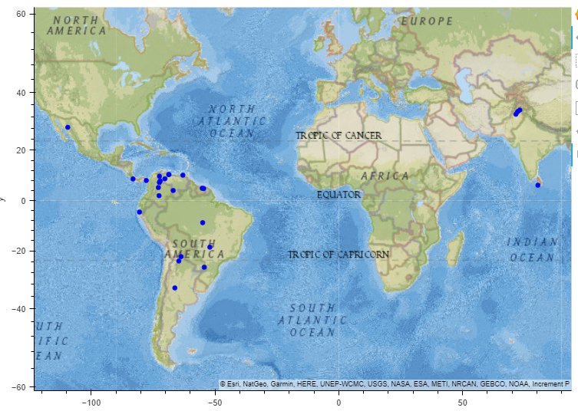
Endangered catfish

Slide 17
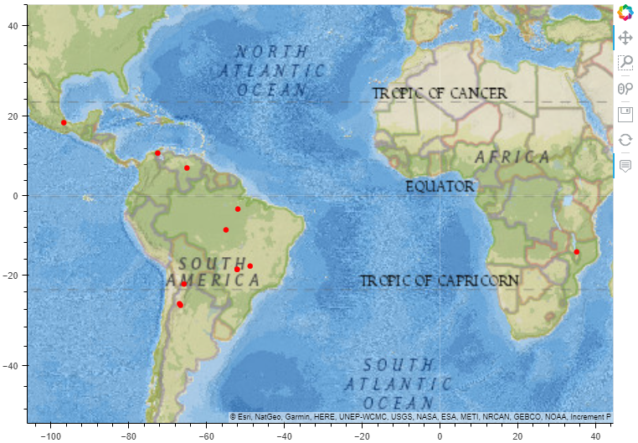
Critically endangered catfish species

Slide 18
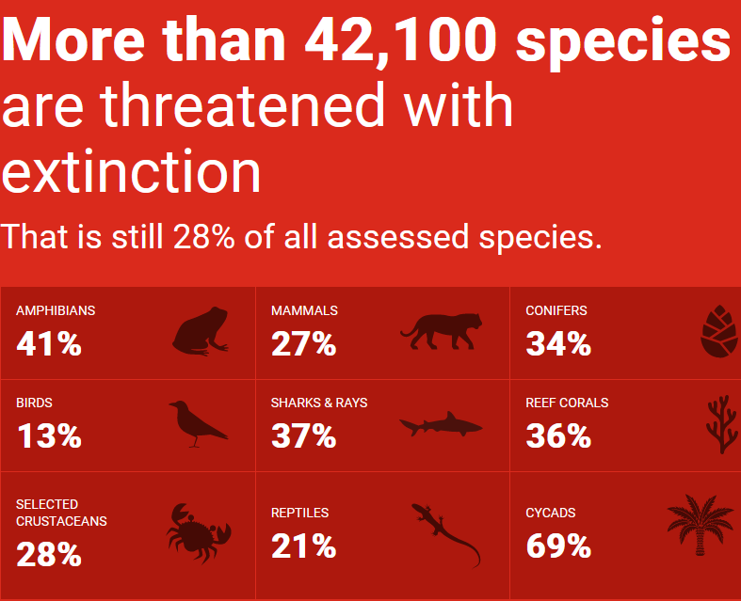
Takeaways
The IUCN Red List Assessment species in the dataset are mostly of “Least Concern”, which would be good but…
this may be influenced by the kinds of organisms that makeup the dataset as there is a bias towards certain organismal groups, particularly Kingdom Animalia and Classes Mammalia and Gastropoda. Kingdom and Class are shown to have significant effect on assessment results.
By contrast, whether a species is native or endemic does not appear to have a relationship, at least for fish in the U.S.
https://www.iucnredlist.org/

Slide 19


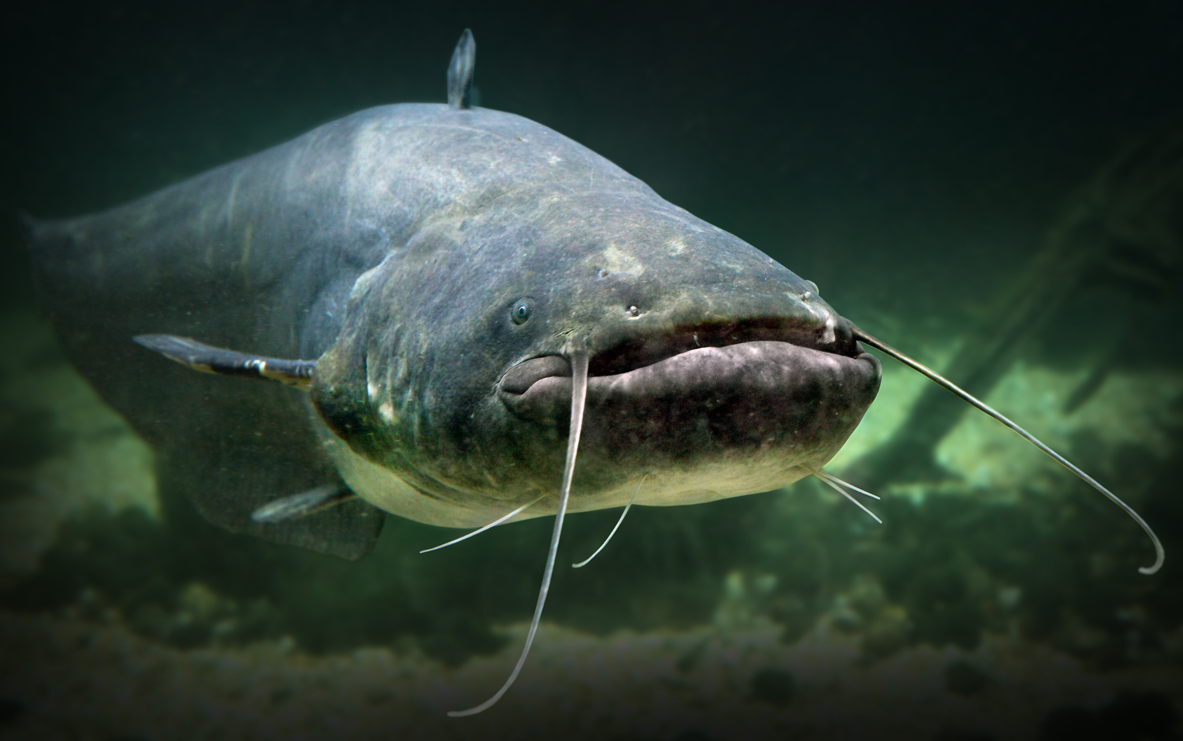
Please recycle

